Slide 1
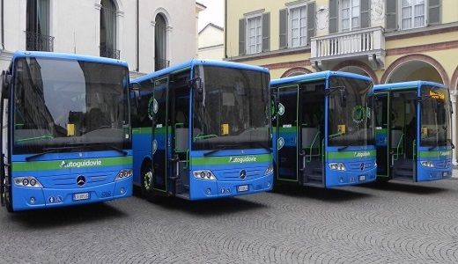


23-06-2021 UPTE 2021– Mobility Engineering
OPTIMIZATION OF THE USE OF A BUS FLEET ACCORDING TO MILEAGETO GROUP 7
Group members
Federico Silvestri
Manjith Kumar REDDY
Mohammed Raihan
Marcela Castillo
Alexis Lema Ordóñez

Slide 2
Agenda
Preface
Design Approach
Objective and constraints
Data exploration
Scenario 1 computation and results
Scenario 2 computation and results
How to implement?
Conclusions and recommendations
Q&A

Slide 3

Preface
Total fleet of 70 buses
10 lines to operate upon
Operation throughout the year

Slide 4
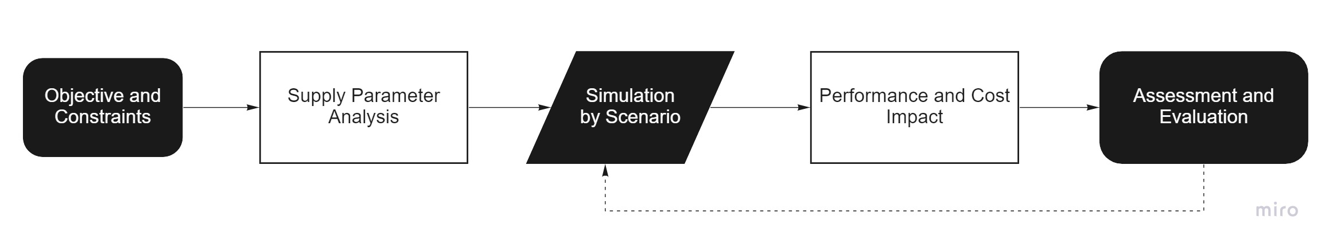
Design Approach – What if ?

Slide 5
Objectives
Definition of a method to optimize the use of a bus fleet according to mileage
Definition of a method that allows a small bus maintenance cost

Slide 6
Constraints
Buses should not travel longer than the specified km range
Shifts LCH18A-01 and LCH18A-02 in Winter Weekdays should run with the 18 m long buses
Buses should have sufficient time to undergo regular maintenance procedures (1 or 2 days)

Slide 7
Data Exploration
12m
FULLSERVICE CONTRACT
INTERNAL

Slide 8
Data Exploration

Slide 9
Scenario 1 - Strategy
The assignment follows a sequential order
Focuses on easy maintenance allotment window
Most of the process is automated

Slide 10
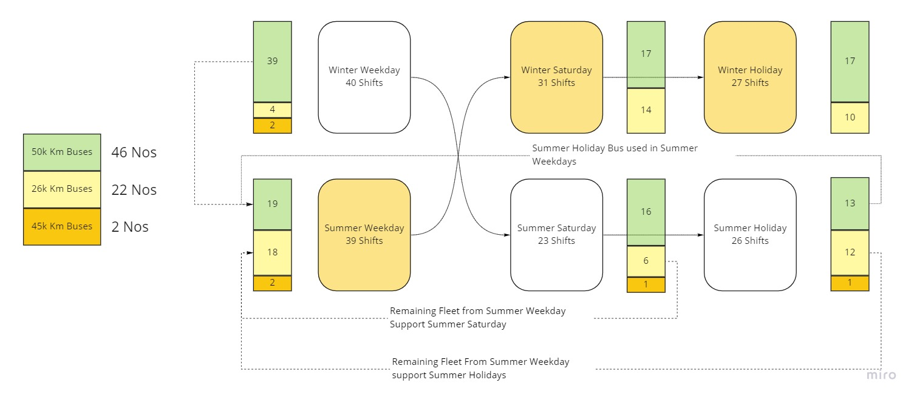
Scenario 1
Sequential Ordering Algorithm

Slide 11
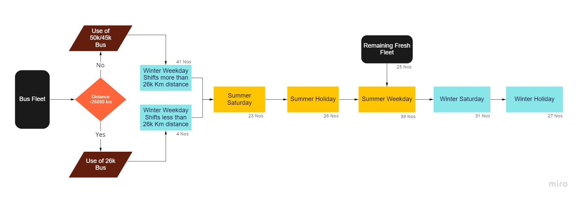
Procedure Sequence

Slide 12
Performance & Impacts
Maintenance cost achieved - € 611.580
Two possible approaches for maintenance
Weekend availability for all buses – 1 or 2 days every week
Off-season maintenance availability for most of them
Simplicity in reusing buses while assignment was obtained

Slide 13
Scenario 1
PROS
cons
Straight forward fleet scheduling method
Sufficient number of days available for maintenance
Less complexity in dealing with constraints
High overall cost
Maximises the use of 26k bus
Disproportionate distances covered by individual buses

Slide 14
Scenario 2 - Strategy
Pushes down the overall cost of maintenance based on Scenario 1
Maximises the use of 50k km bus since they are the lowest cost to maintain per km
Compares the performance to Scenario 1 and evaluate

Slide 15
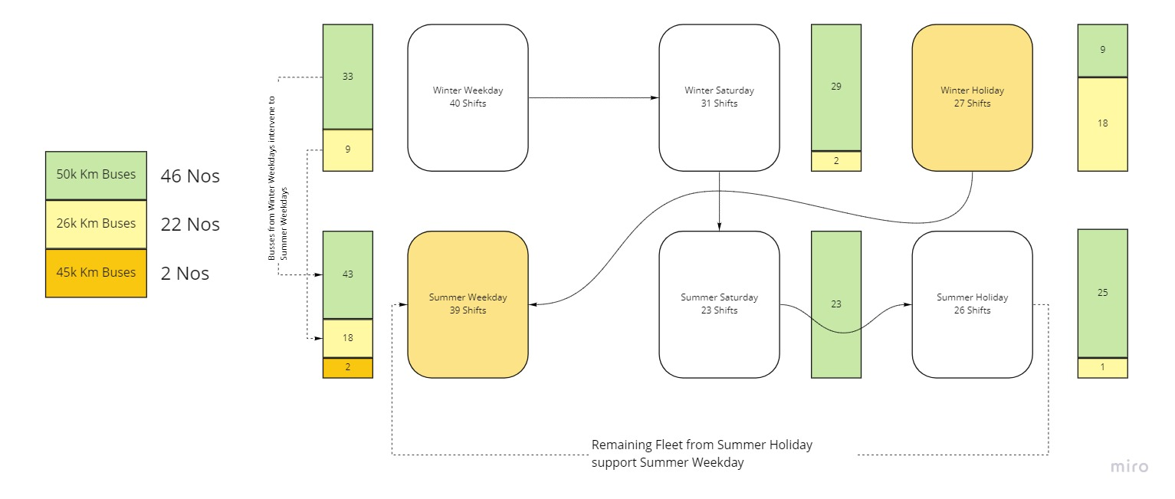
Scenario 2
Maximising use of 50K km Bus

Slide 16
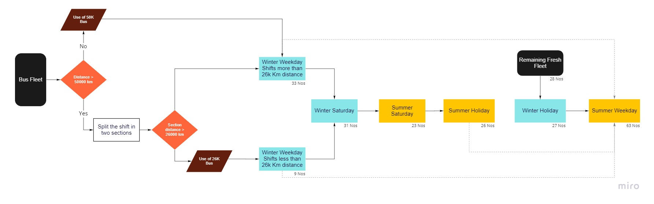
Procedure Sequence

Slide 17
Performance & Impacts
Maintenance cost achieved - € 558.286
Two possible approaches for maintenance:
1 day per week
Off-season maintenance for a few of them
Complexity in assigning a single bus for an entire season

Slide 18
Scenario 2
PROS
cons
Low overall cost
Balanced distance covered by individual buses
Maximises the use of 50k km Bus
2 buses completely free (most expensive to maintain) for emergency runs
Complicated scheduling method, requiring manual intervention to meet the constraints

Slide 19
Costs comparison

Slide 20
How to implement?
Scheduling over the year
Scheduling over a day
Operative calendar

Slide 21
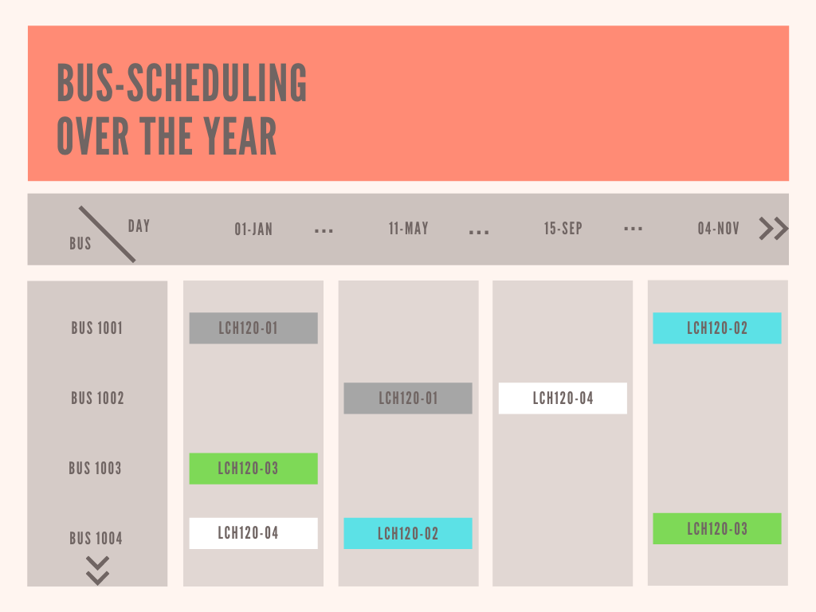
SCHEDULING OVER THE YEAR
- Shows all buses with the assigned shifts on all days of the year.
- Uses colour classification to make easy the interpretation.

Slide 22
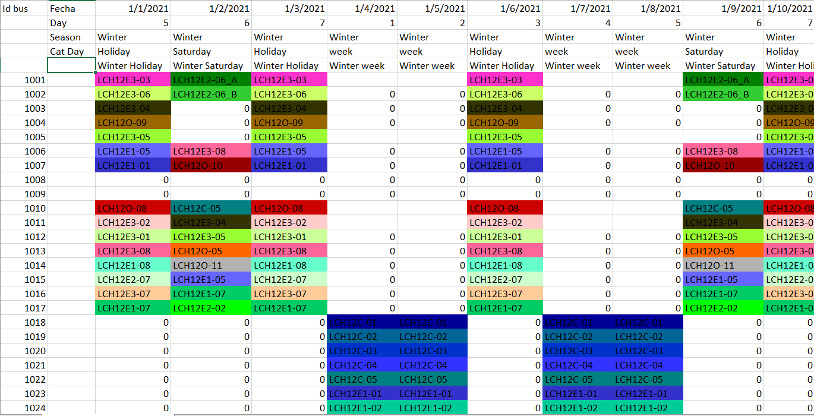
SCHEDULING OVER THE YEAR
- Shows all buses with the assigned shifts on all days of the year.
- Uses colour classification to make easy the interpretation.

Slide 23
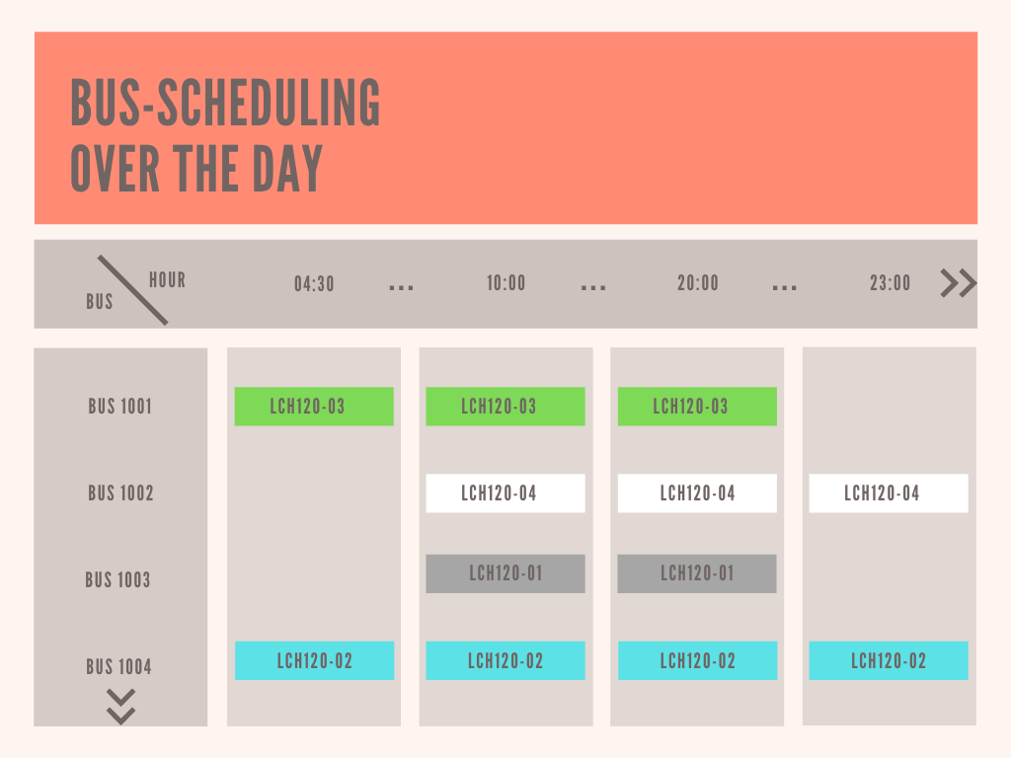
SCHEDULING OVER A DAY
- Shows all buses with the assigned shifts on all hours of the day.
- Uses colour classification to make easy the interpretation.

Slide 24
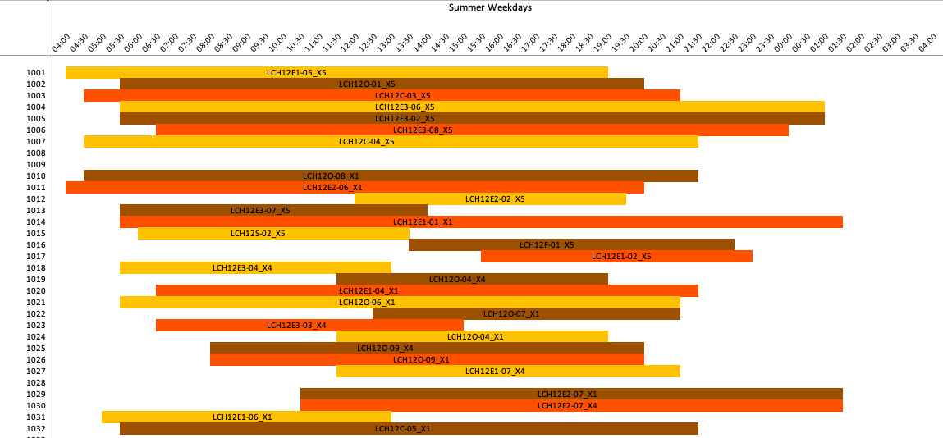
SCHEDULING OVER A DAY
SUMMER WEEKDAYS

Slide 25
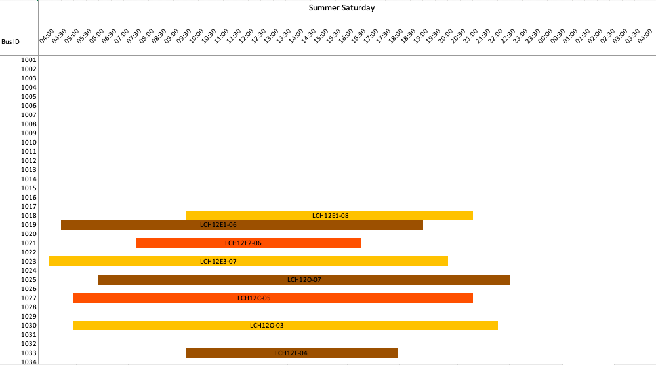
SCHEDULING OVER A DAY
SUMMER SATURDAYS

Slide 26
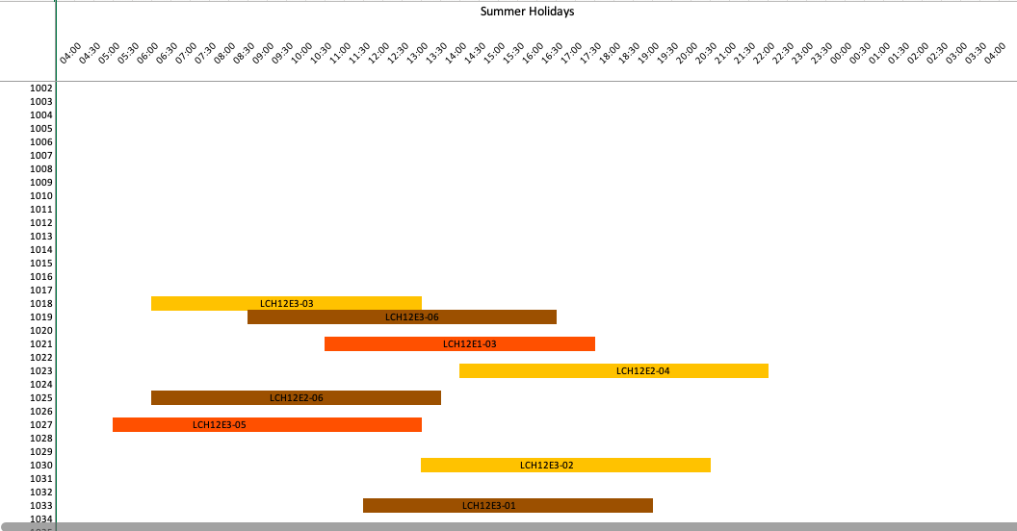
SCHEDULING OVER A DAY
SUMMER HOLIDAYS

Slide 27
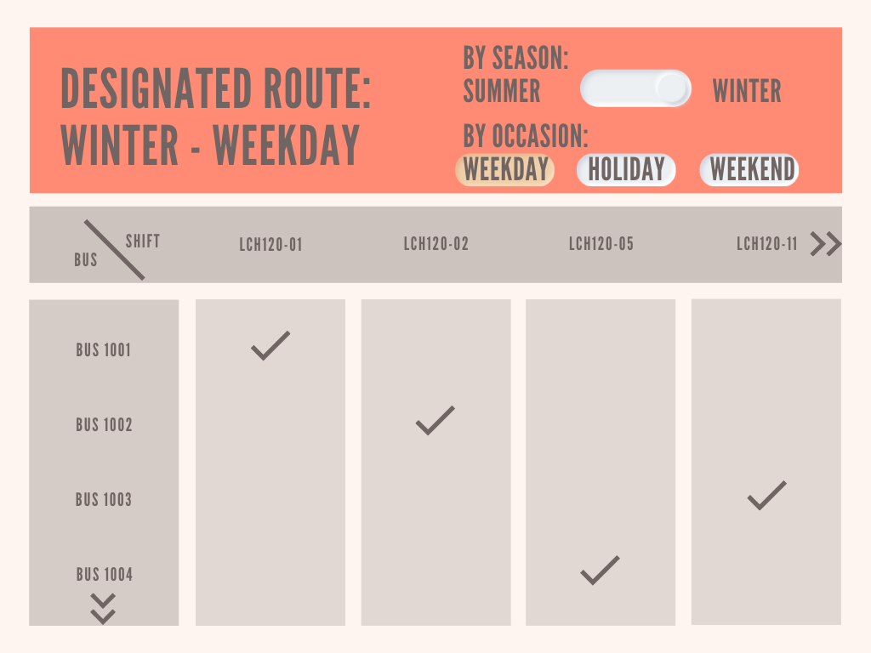
OPERATIVE CALENDAR
- Simple way to use the algorithm.
- Shows all shifts with the assigned buses to reach the proposed goals.
- Allows the selection by season, occasion or a specific date.
- Makes the daily assignment of buses easy.

Slide 28
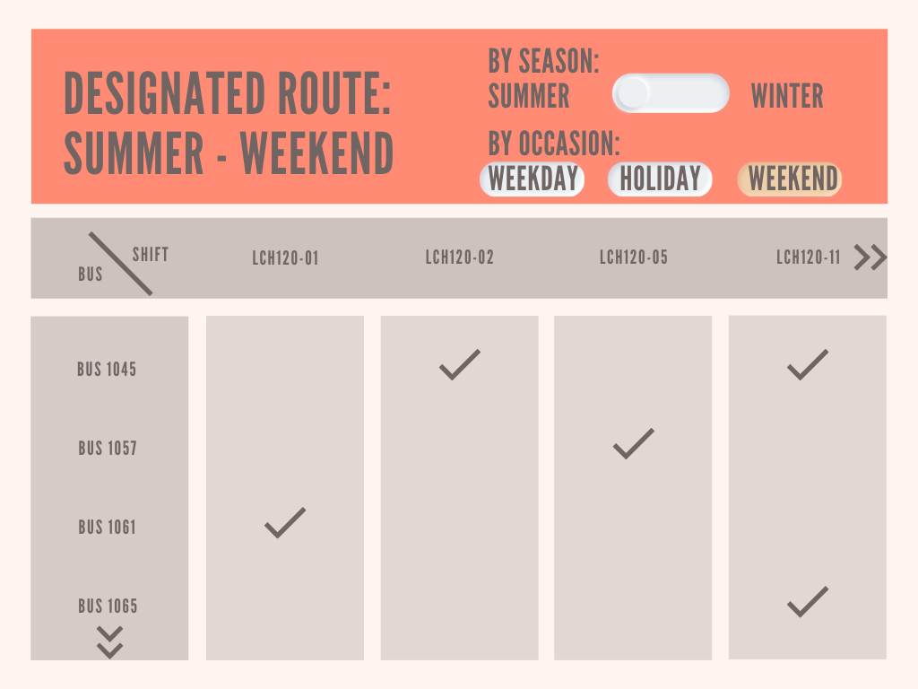

OPERATIVE CALENDAR
- Simple way to use the algorithm.
- Shows all shifts with the assigned buses to reach the proposed goals.
- Allows the selection by season, occasion or a specific date.
- Makes the daily assignment of buses easy.

Slide 29
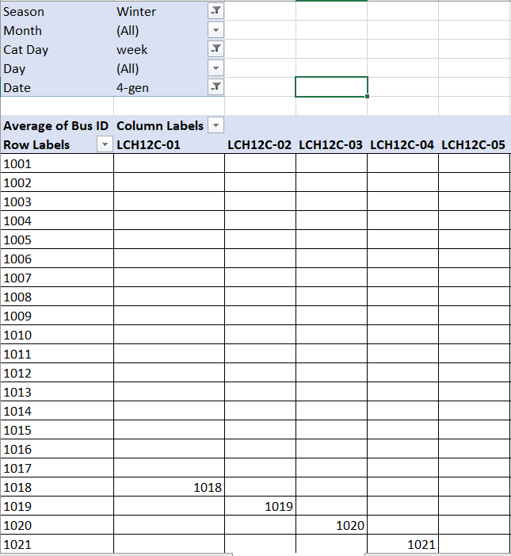
OPERATIVE CALENDAR
- Simple way to use the algorithm.
- Shows all shifts with the assigned buses to reach the proposed goals.
- Allows the selection by season, occasion or a specific date.
- Makes the daily assignment of buses easy.

Slide 30
Conclusions
Last scenario is the best option with a difference of almost 50k € for maintenance in contrast of first simulation
Bus variables as maintenance cost per km, kind of contract and acquisition year are very influential for the bus-scheduling over the year
A bus fleet need to have a back up of vehicles to give a guaranteed service over a total period and keep a regular maintenance

Slide 31
Recommendations
The availability of buses in real-time should be considered while using the algorithm to solve unexpected problems with buses.
Using a database motor would be more efficient to operate and improve the algorithm.

Slide 32

THANK YOU FOR YOUR ATTENTION
CONTACTS
Federico Silvestri: federico1.silvestri@mail.polimi.it
Manjith Kumar: manjithkumar.sirigireddy@mail.polimi.it
Mohammed Raihan: mohammedraihan@mail.polimi.it
Marcela Castillo: marcela.castillo@mail.polimi.it
Alexis Lema Ordóñez: alexisfernando.lema@mail.polimi.it

